Slide 1
Devotee Management Application

Slide 2
Form Building
The application is built by utilizing Zoho Creator’s drag and drop features and a bit of coding using deluge script language .
Further more about the process is explained below with the help of screenshots.

Slide 3
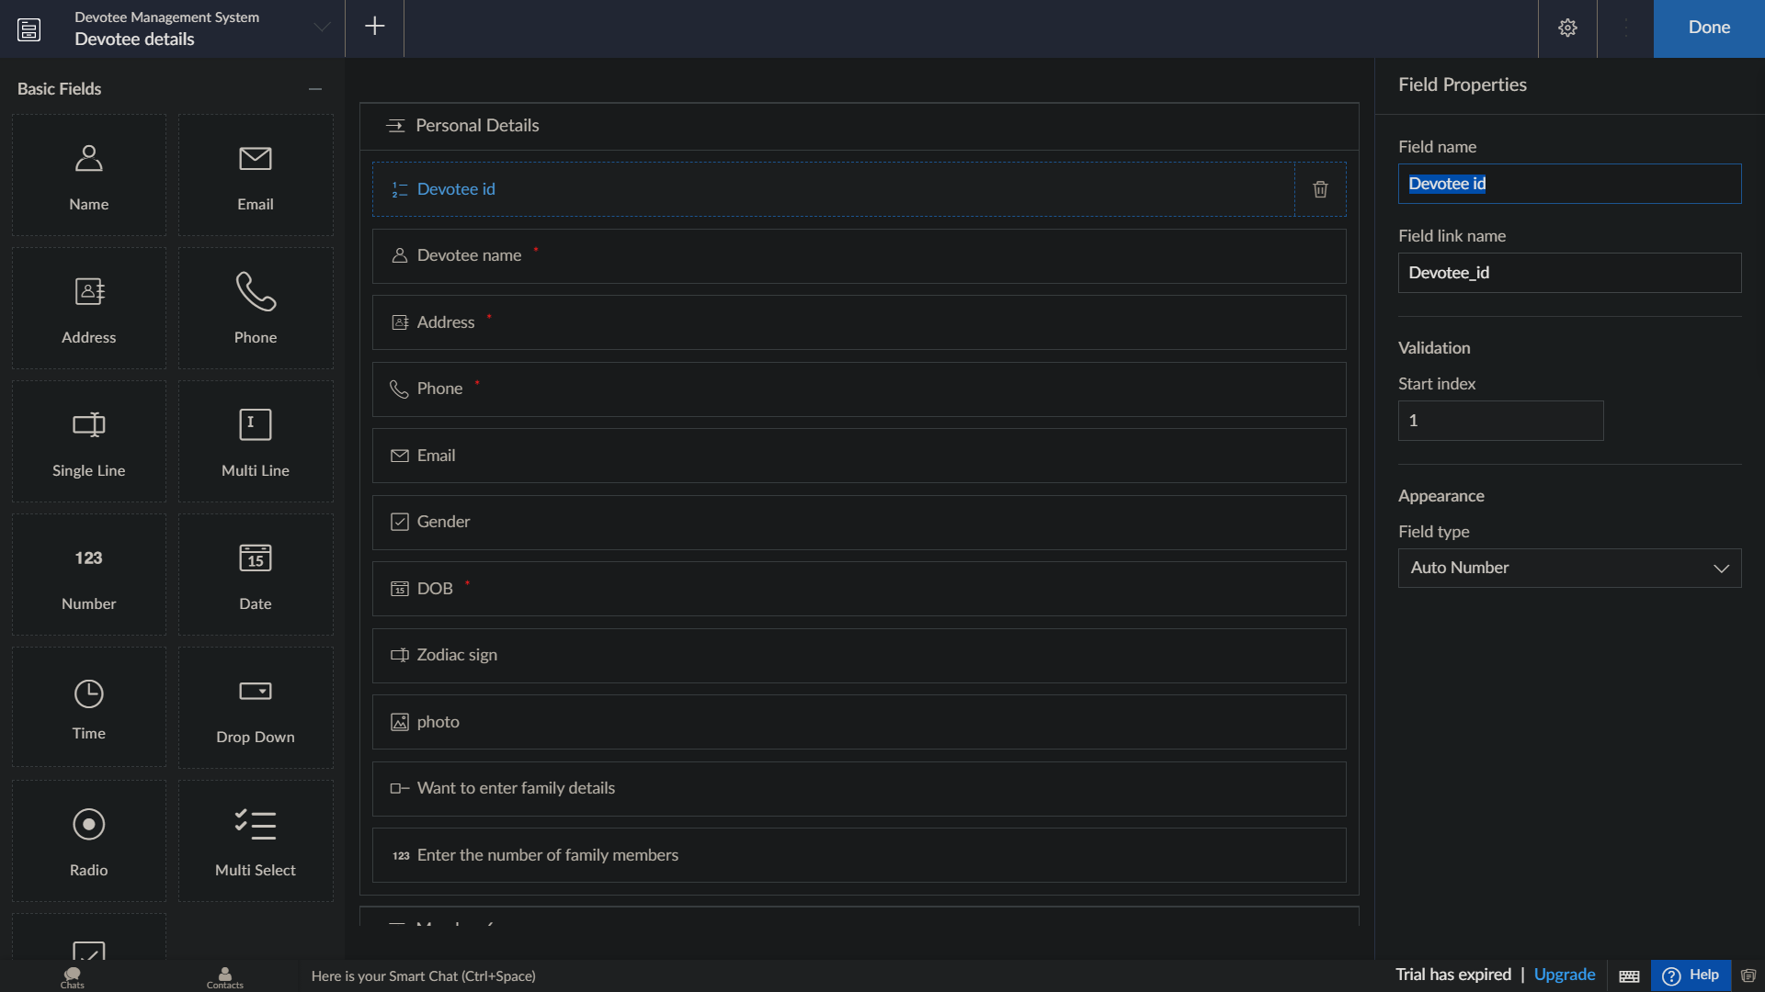
Devotee id is an auto generated number which increments automatically for every devotee registered

Slide 4
Workflows are basically the set of actions or works that can be performed for certain purposes/conditions are met.
There are 3 workflows associated with the devotee form
One for validating date of birth.
The other two is to either display or keep the subform for filling out the family members
details hidden based on a devotee choice.

Slide 5
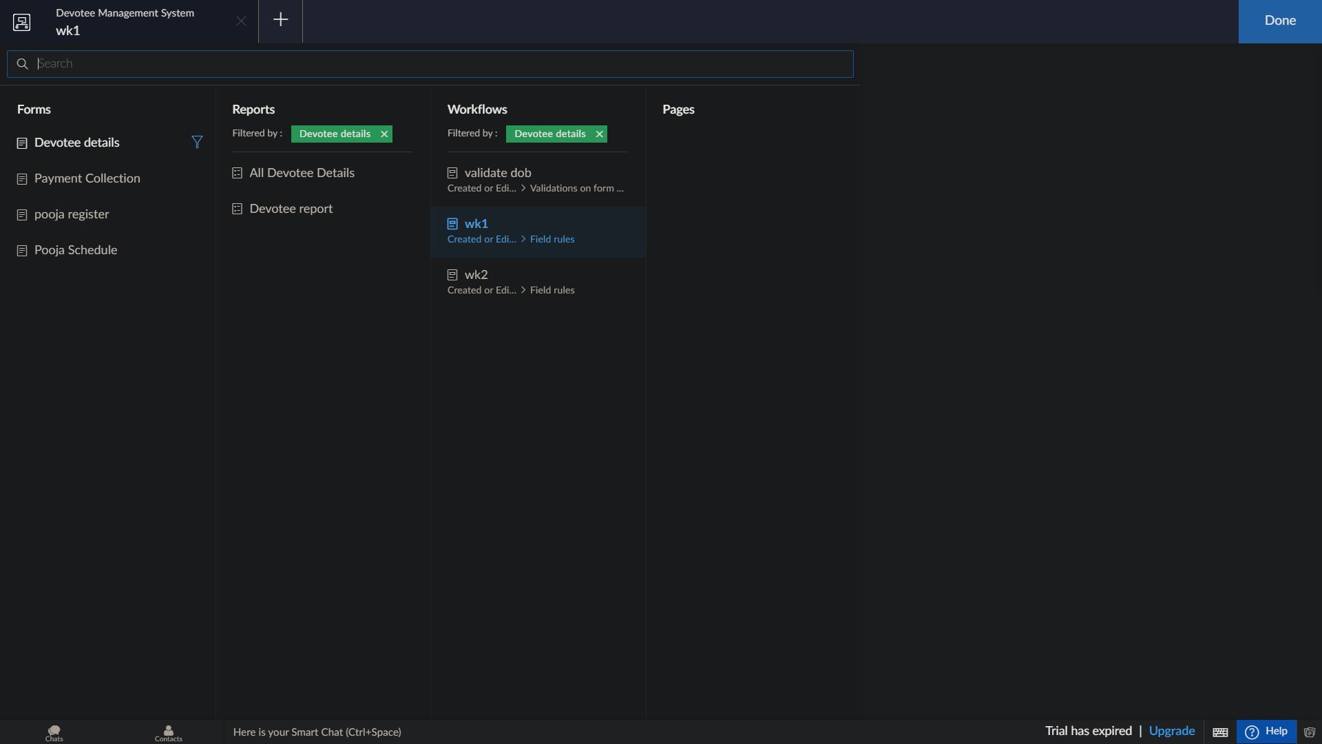

Slide 6
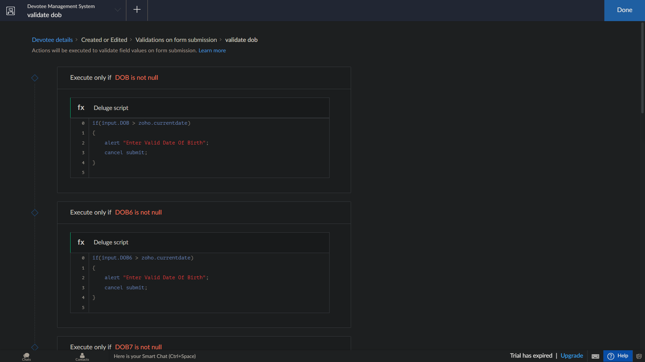

Slide 7
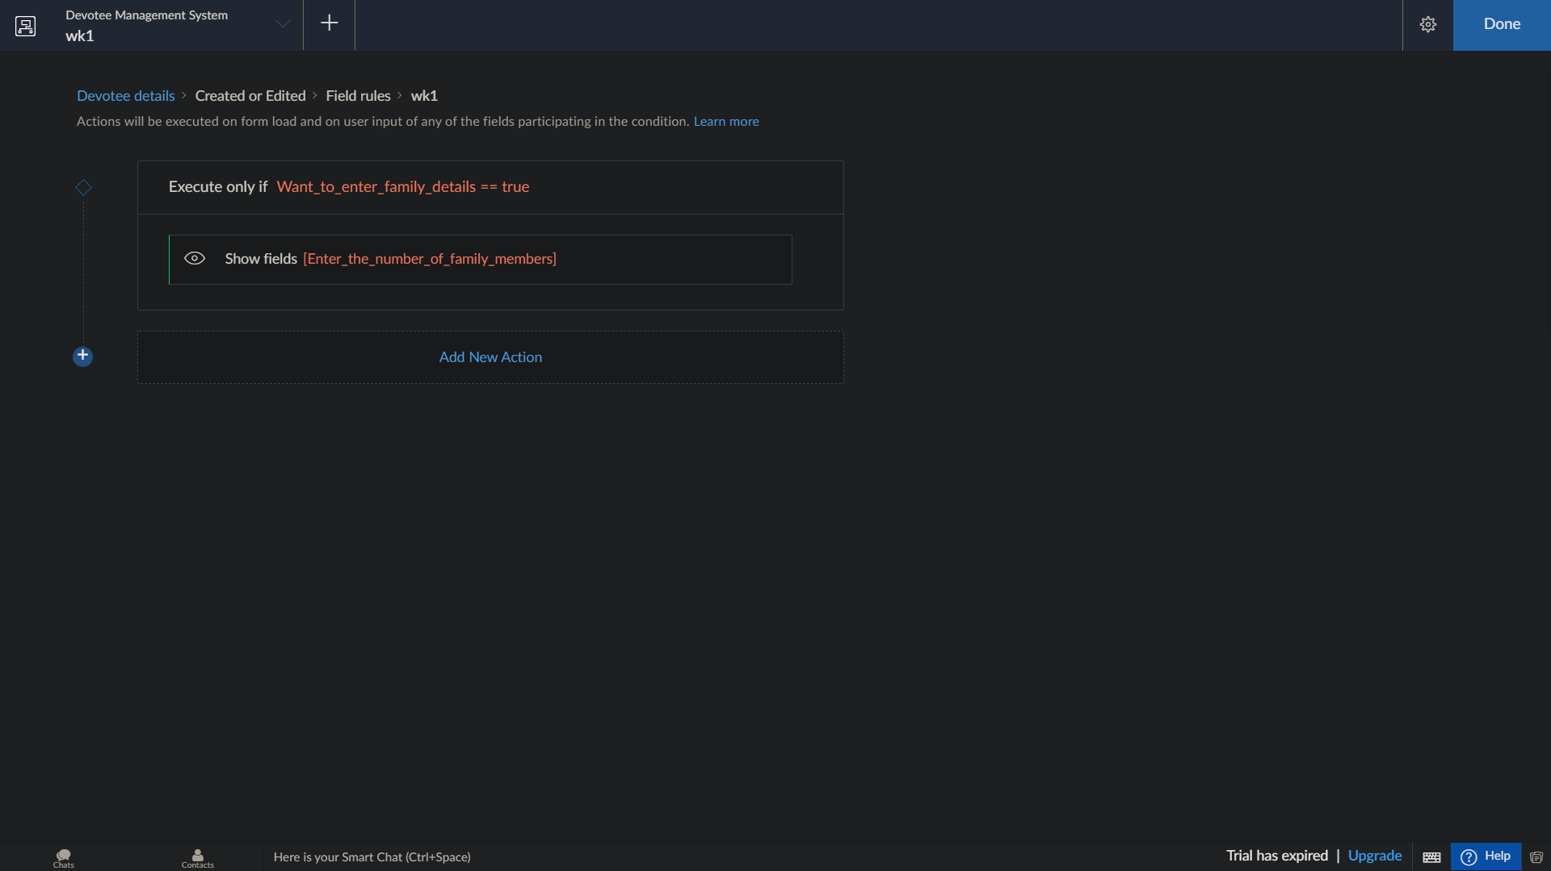

Slide 8
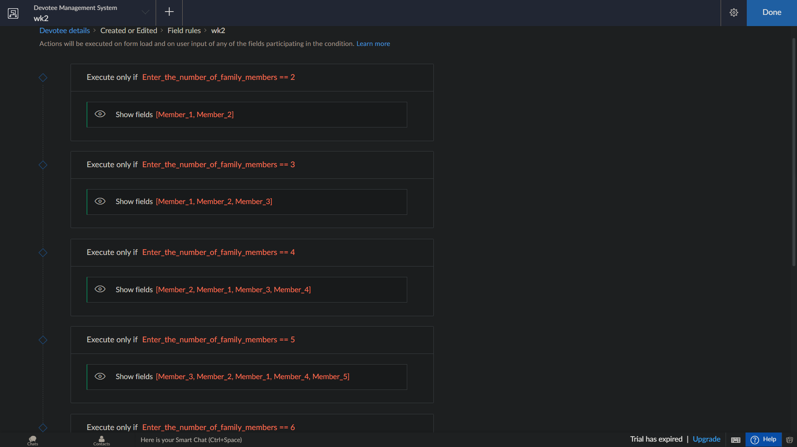

Slide 9
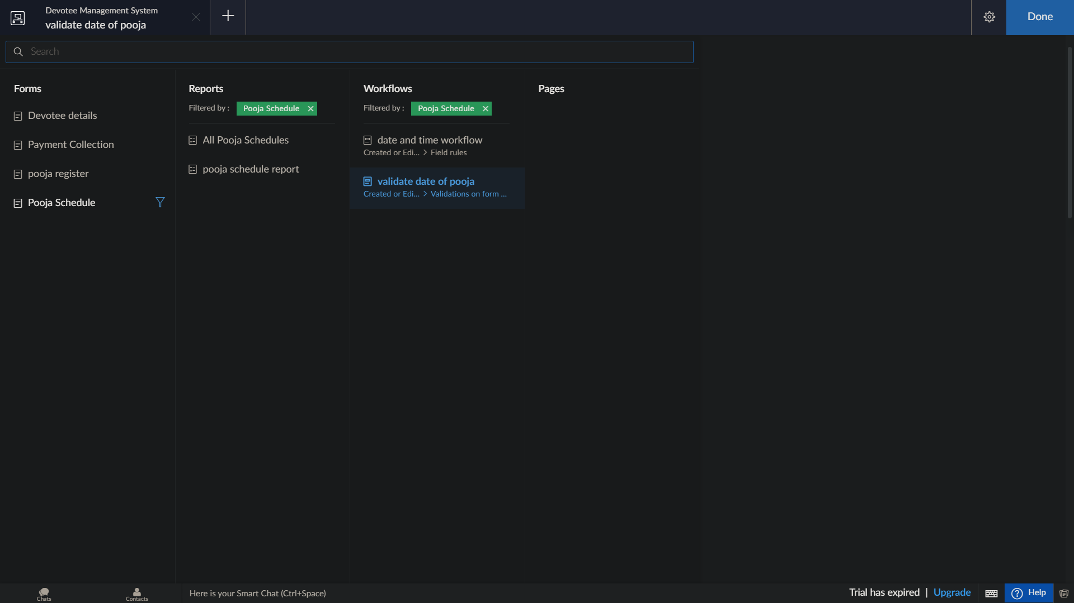
Pooja and payment from has also workflows associated with them.

Slide 10
Few screenshots of the devotee application

Slide 11
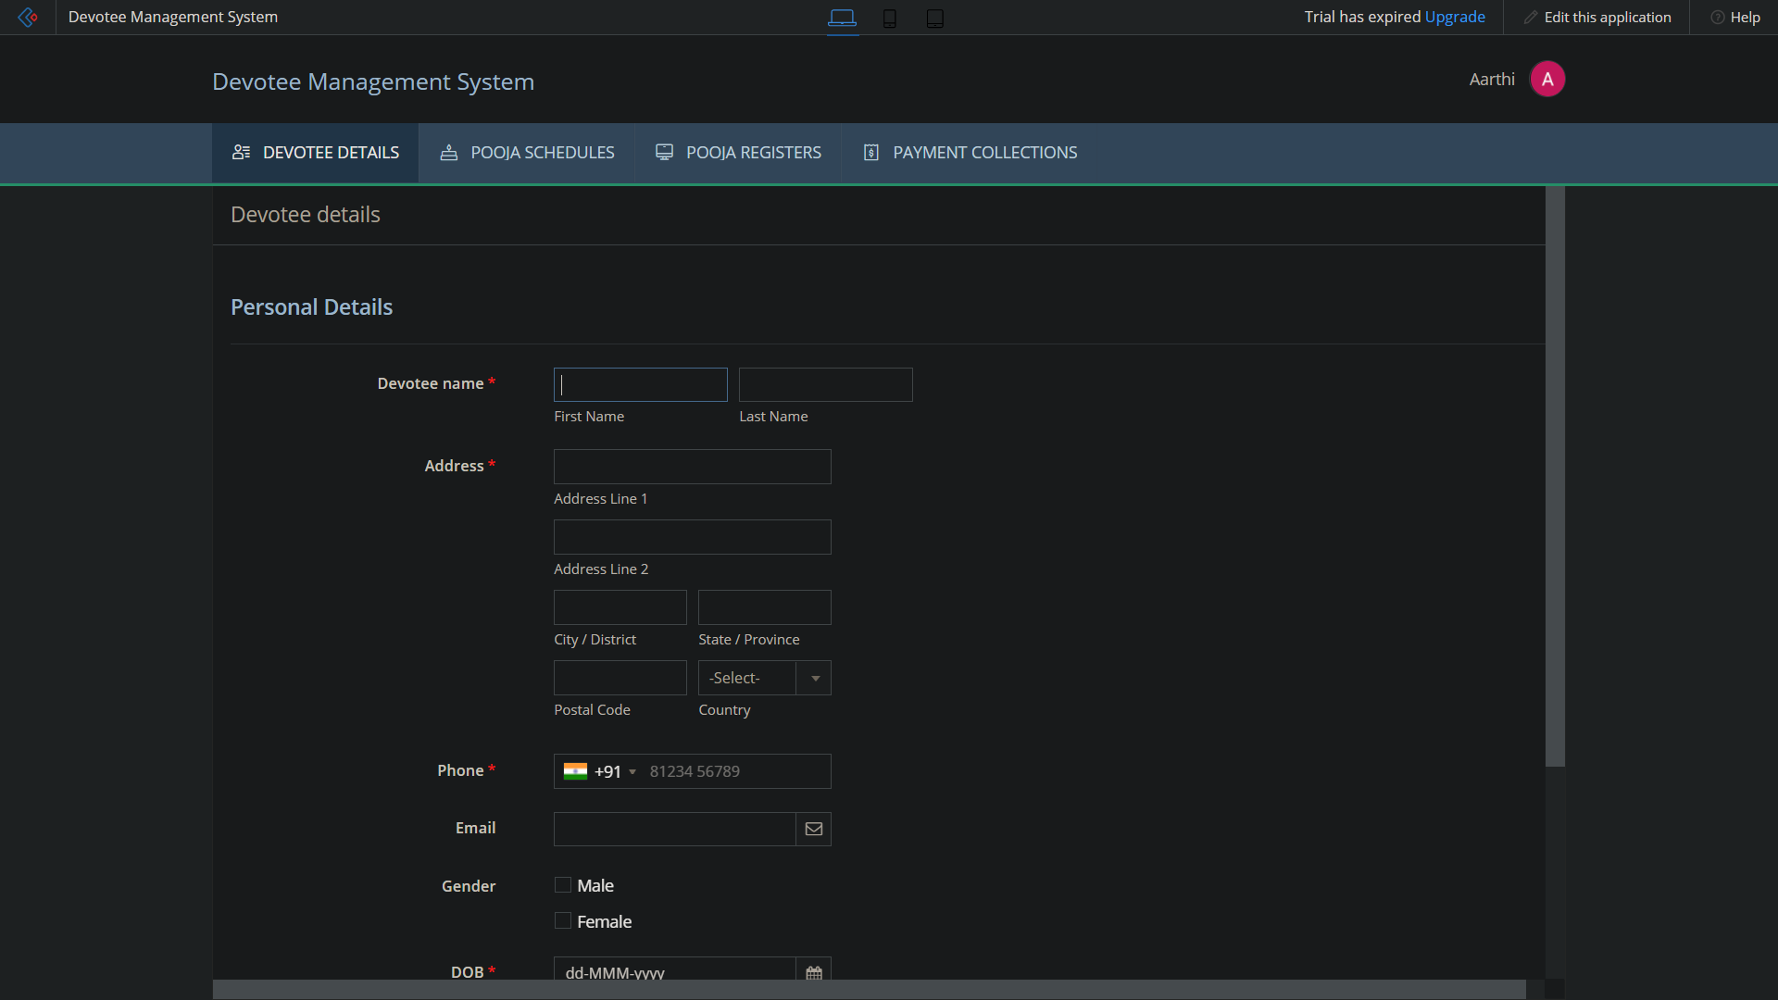

Slide 12
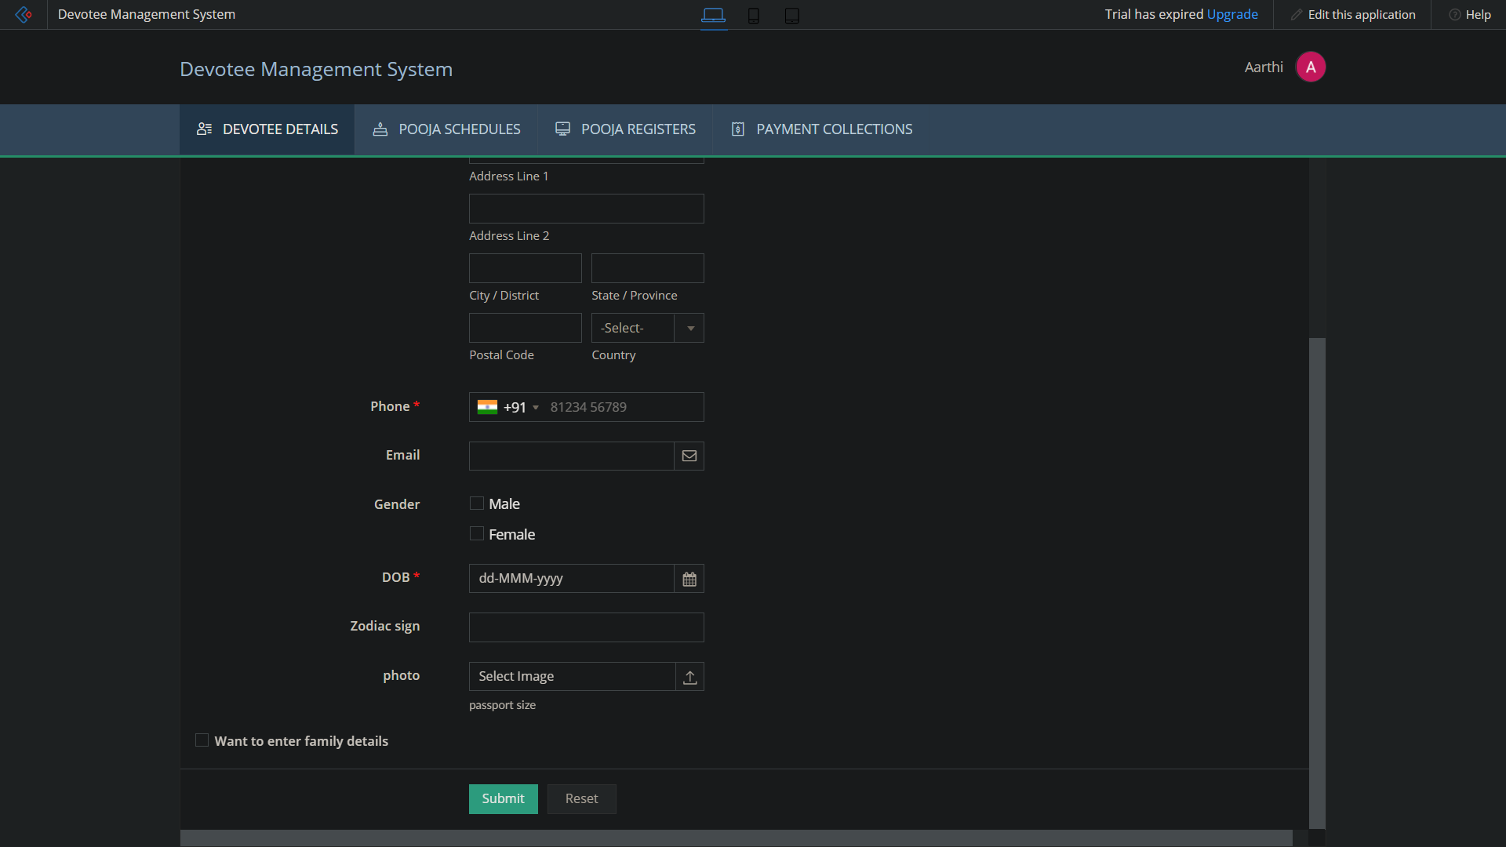

Slide 13
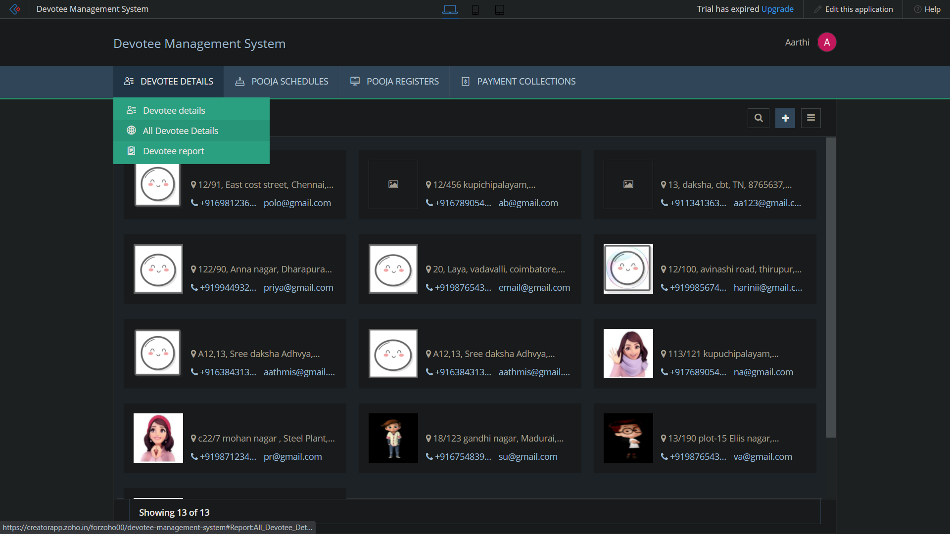

Slide 14
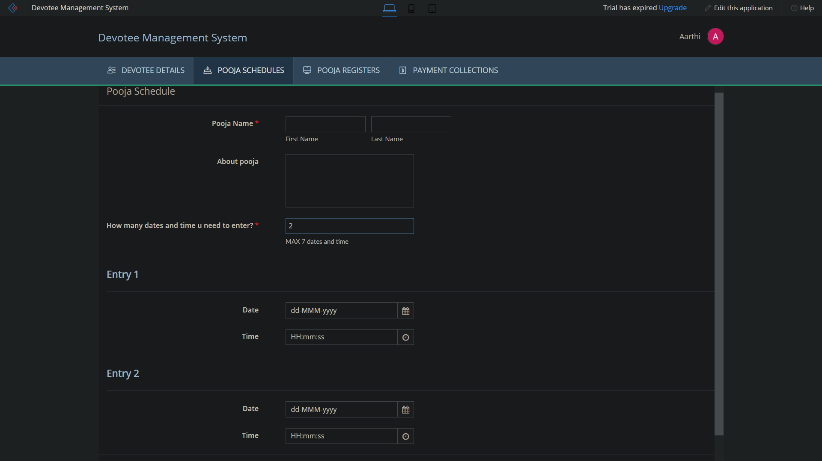

Slide 15
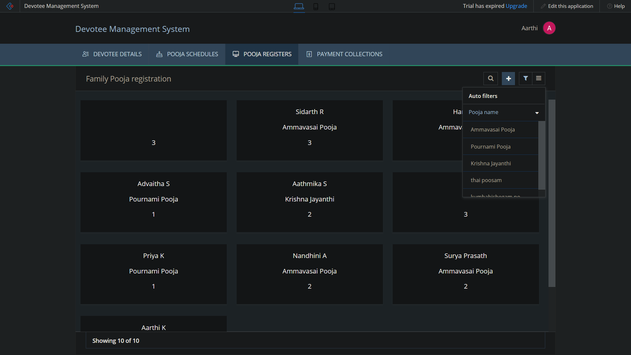

Slide 16
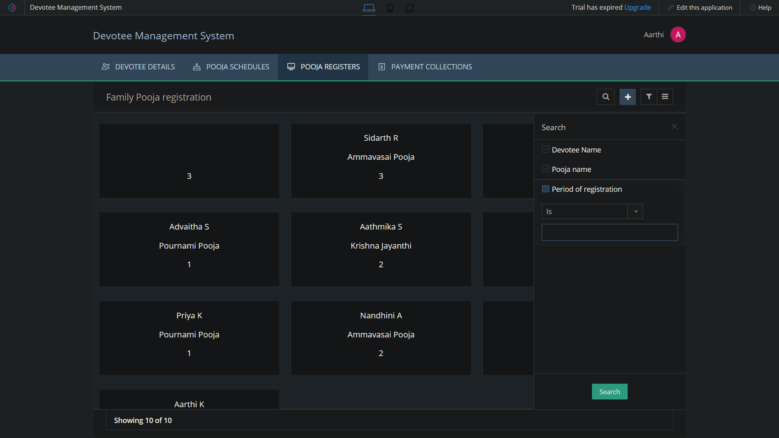

Slide 17
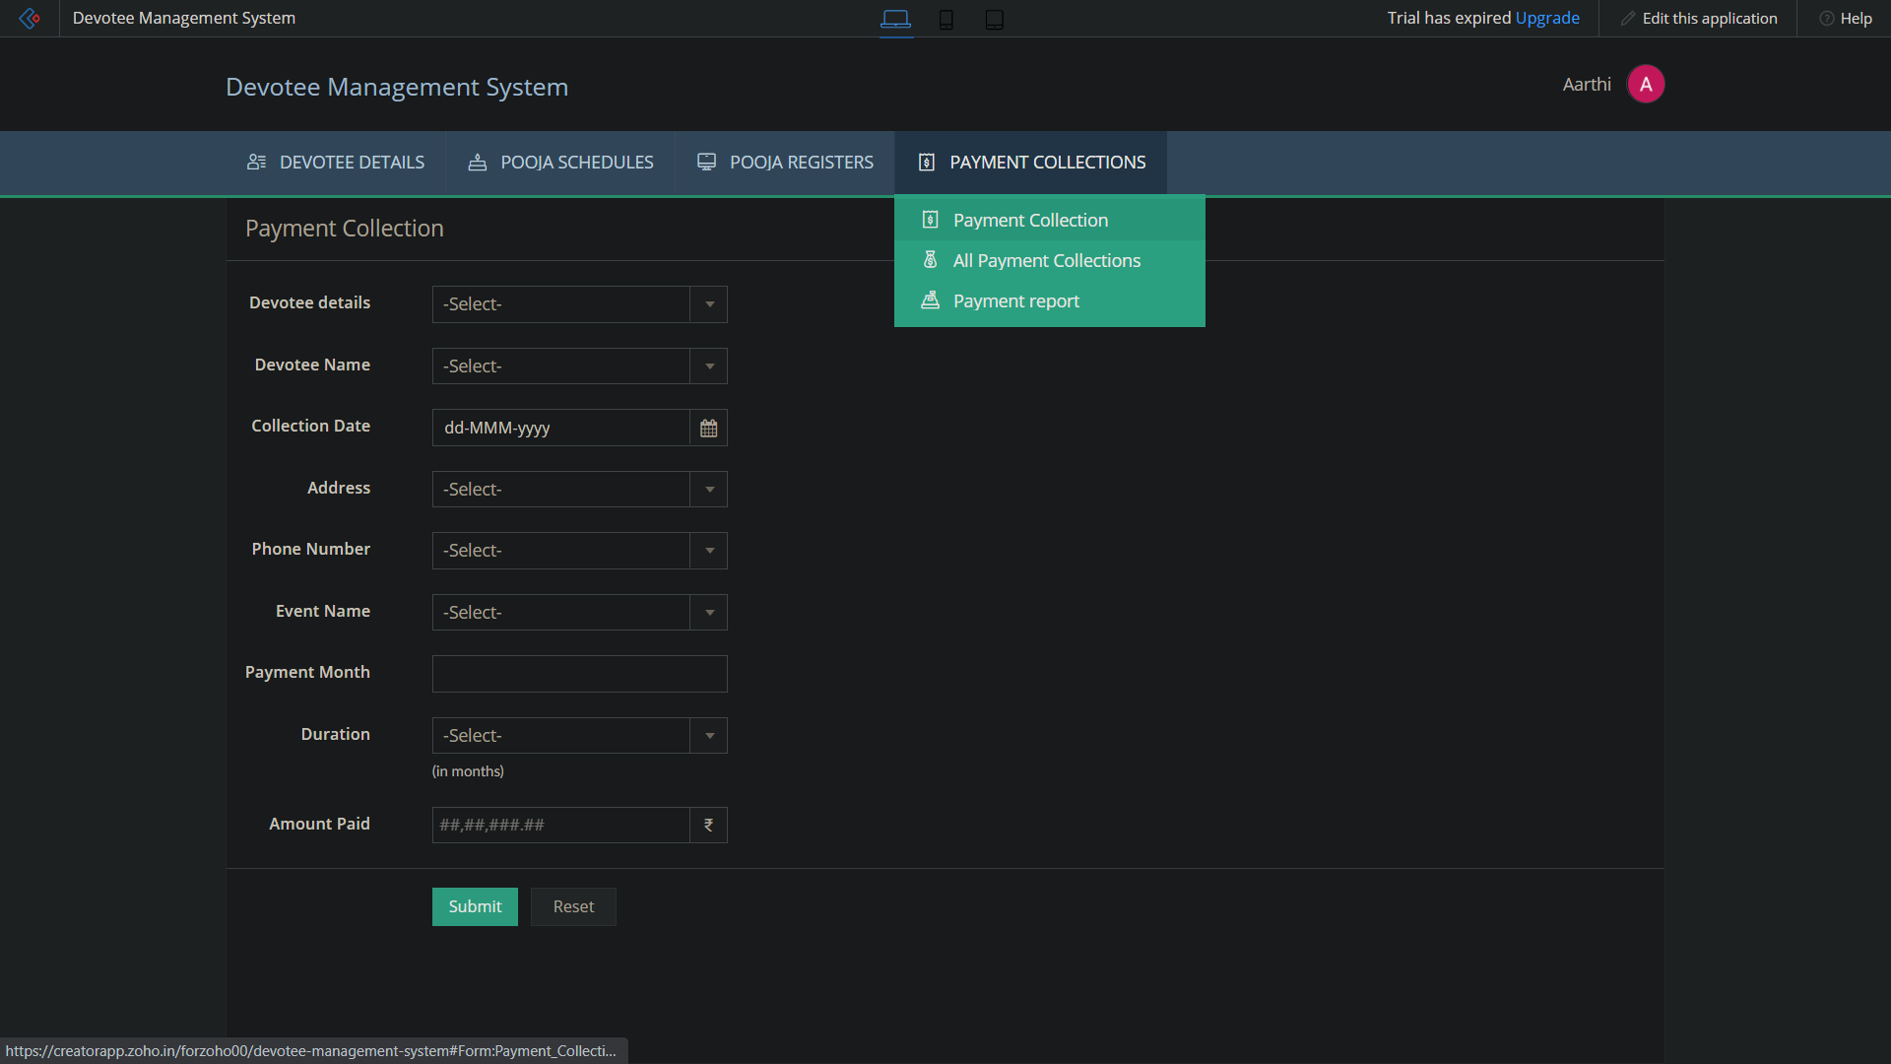

Slide 18
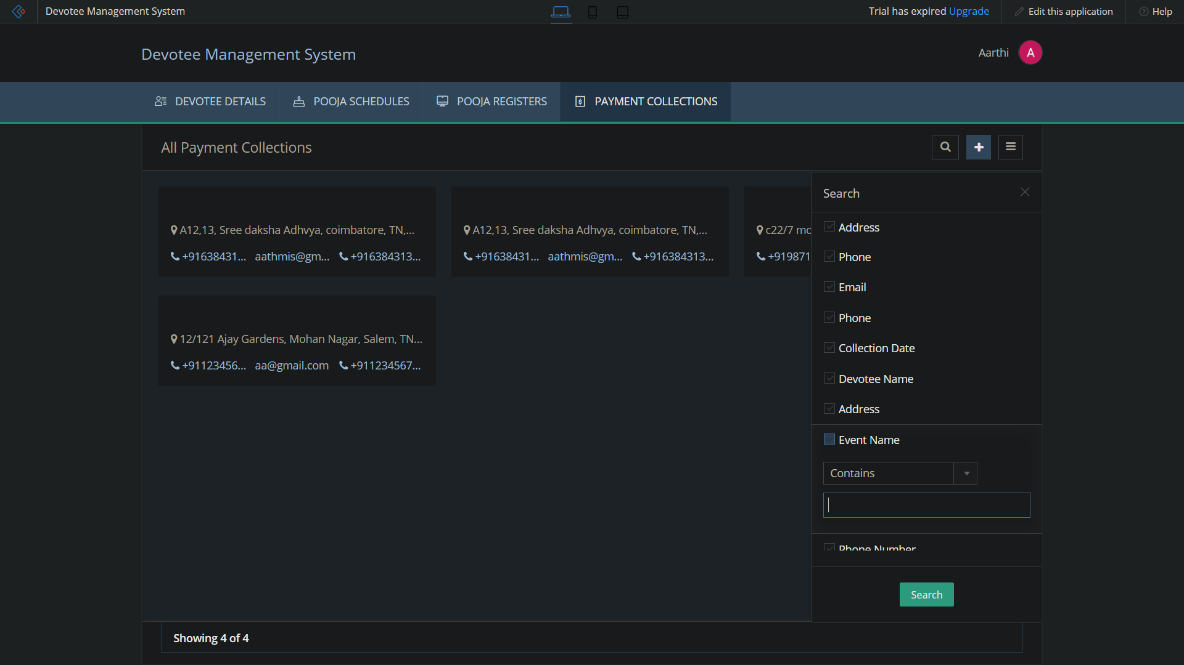

Slide 19
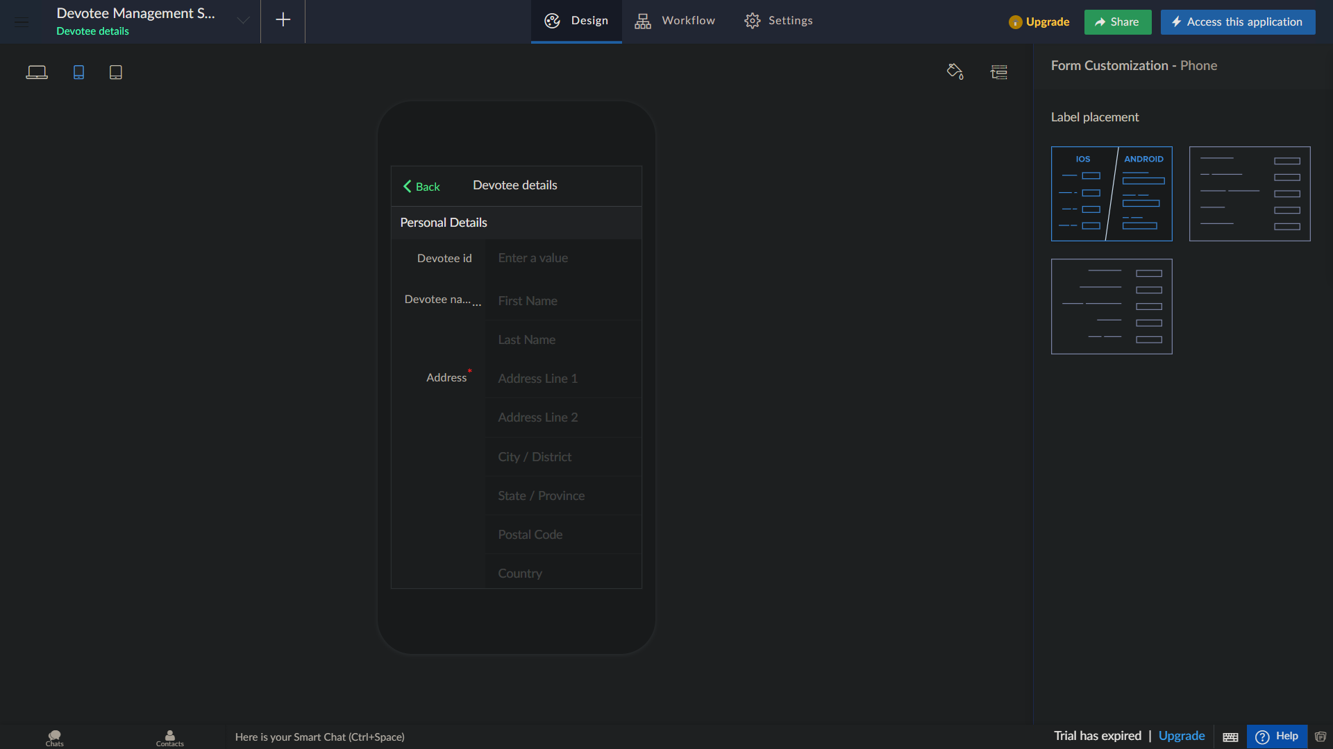
Can be accessed via phone

Slide 20
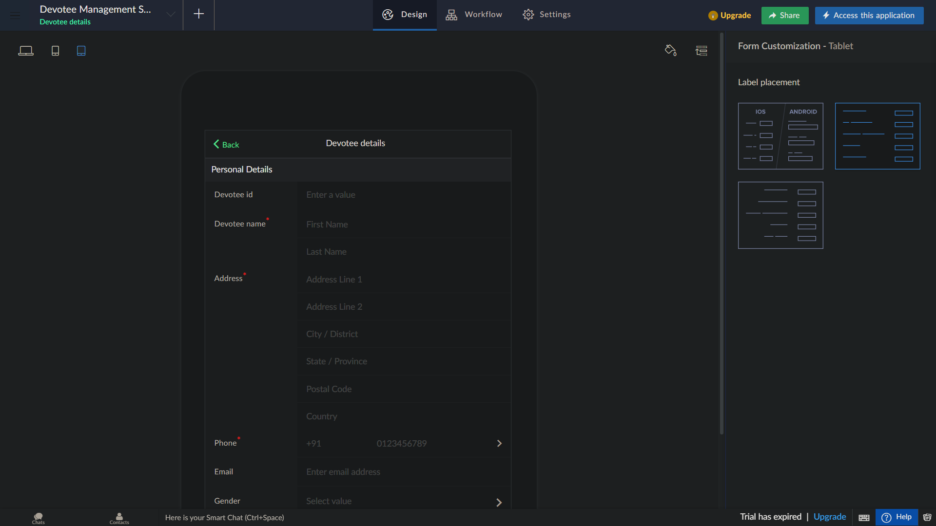
Can be accessed via tablet

Slide 21
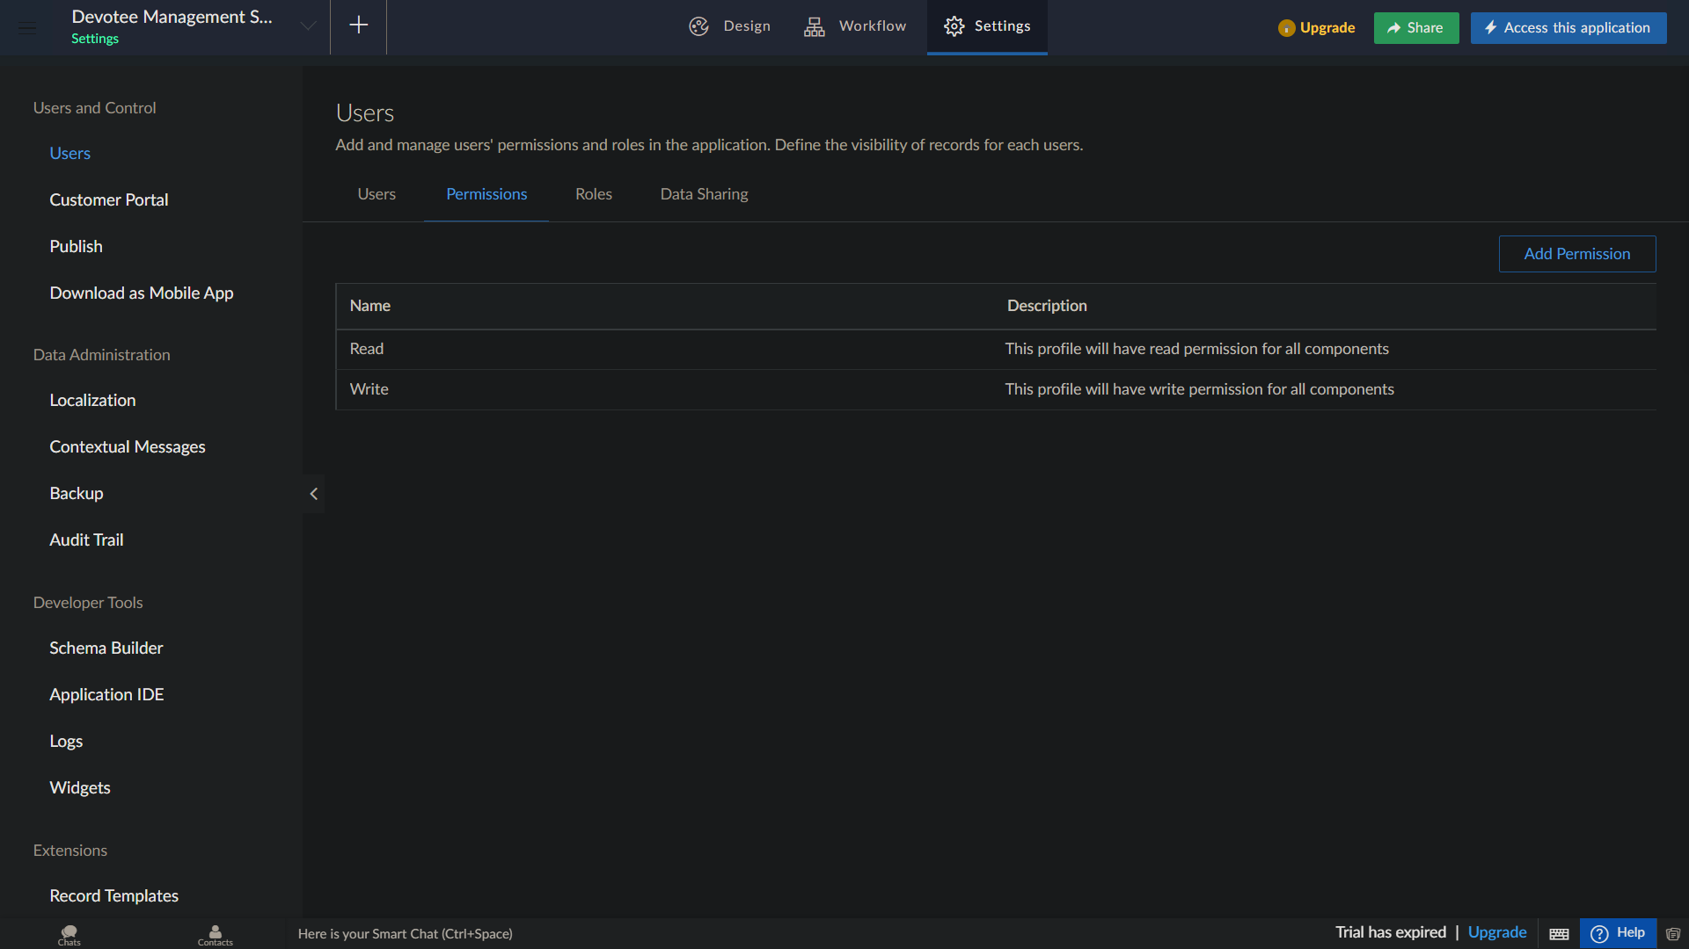
The application can be shared to users,developers with appropriate permission over the forms.

Slide 22
Zoho creator Account details
Email id : forzoho00@gmail.com
Password : zohoacct01

